Slide 1
CSE7302 – PROJECT Review-2 Presentation
Batch Number: CSE_104 Internship/Industrial Training with Placement Opportunity
Under the Supervision of,
Dr. T Ramesh
Assistant Professor
Presidency School of CSE
Presidency University
Name | Roll No
Manjunatha | 20221CSE0600
Mamatha S M | 20221CSE0599
Archana P | 20221CSE0569
Name of the Program: B.Tech Computer Science And Engineering
Name of the HoD: Dr. Blessed Prince P
Name of the Program Project Coordinator: Mr. Muthuraju V
Name of the School Internship Coordinator: Dr. Sampath A K, Dr. Geetha A

Slide 2
Content
Abstract
Literature Survey
Objectives
Existing Methods and drawbacks
Proposed Method and Feasability
Architecture Diagram
Modules
System Requirements
Timeline
Project Roadmap
Github Link

Slide 3
ABSTRACT
Internship and placement processes in technical institutions are manual, fragmented, and inefficient
Students depend on WhatsApp, emails, and physical approvals, leading to missed opportunities
Placement cells face poor visibility and heavy administrative workload
Proposed solution: an AI-driven, campus-centric internship & placement portal
Provides a single verified digital student profile for all applications
Automates mentor approvals, interview scheduling, and progress tracking
Enables skill-based opportunity matching and real-time placement analytics
Supervisor feedback triggers certificate generation and employability updates
Designed to be low-cost, secure, scalable, and role-based

Slide 4
LITERATURE SURVEY
Existing research focuses on either internships or placements, not both
Centralized placement portals improve tracking but ignore internship lifecycle
Internship portals support applications but lack placement conversion analysis
AI-based systems use basic resume filtering or rule-based matching
Limited support for mentor approvals and academic scheduling
Commercial platforms (Internshala, Superset) focus on job discovery, not campus workflows
Most systems lack real-time dashboards and predictive analytics
Certificate generation and verification are mostly manual or absent
Research gap identified: No unified, end-to-end, campus-centric solution
This motivates the proposed integrated AI-driven internship-to-placement platform

Slide 5
OBJECTIVES
OBJ-1: To design a centralized, campus-centric platform that integrates internship and placement management into a single digital system.
OBJ-2: To implement skill-based opportunity matching and application lifecycle tracking to improve internship-to-placement outcomes.
OBJ-3: To automate mentor approvals, feedback, and certificate generation while ensuring data security through role-based access control.

Slide 6
EXISTING METHODS AND DRAWBACKS
Existing internship and placement processes rely on fragmented tools such as WhatsApp groups, emails, spreadsheets, and manual approvals. Some digital portals focus only on job postings without integrating academic workflows. AI-based job portals emphasize discovery rather than institutional coordination. Drawbacks:
Lack of centralized data repository
Manual mentor approvals causing delays
No intelligent skill-based matching
Poor tracking of student placement status
Absence of real-time analytics
No linkage between internship outcomes and placement decisions
These limitations highlight the need for an integrated campus-centric platform.

Slide 7
PROPOSED METHOD & FEASIBILITY STUDY
Proposed Method
Integrates internship and placement management into one platform
Maintains a single verified student profile (academics, skills, resume)
Placement cell posts opportunities with skill tags and conversion potential
AI engine performs skill-based opportunity matching
Automated mentor approval workflow reduces delays
Interview schedules align with academic timetables
Feedback → digital certificate generation & employability record update
Feasibility Study
Uses open-source technologies, minimizing cost
Cloud-based deployment ensures scalability and availability
Modular design supports incremental development and future upgrades
Aligns with existing institutional infrastructure, making it practical

Slide 8
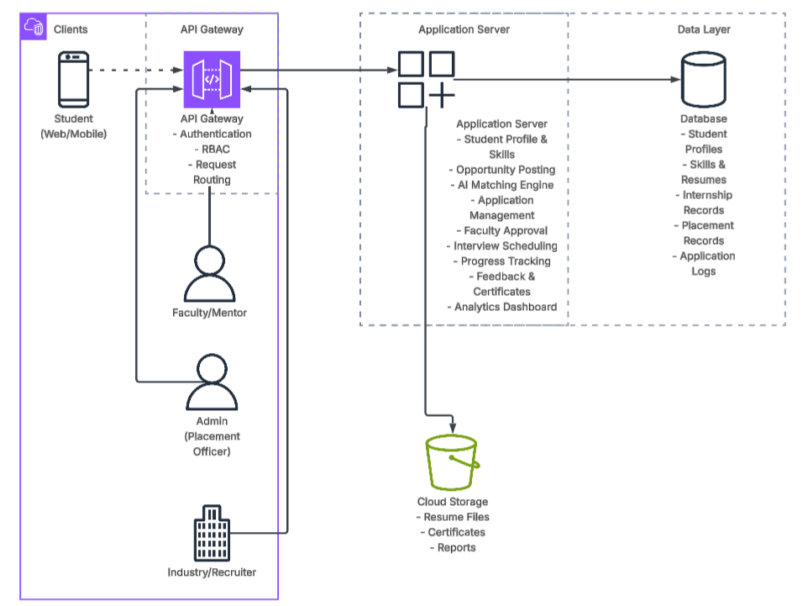
ARCHITECTURE DIAGRAM

Slide 9
MODULES
System Modules
Student Module
Placement Cell Module
Faculty Mentor Module
Industry/Recruiter Module
Internship & Job Posting Module
Skill-Based Matching Module
Application Lifecycle Tracking Module
Feedback & Certificate Generation Module
Analytics & Reporting Module

Slide 10
HARDWARE AND SOFTWARE DETAILS
Hardware Requirements
Standard PC/Laptop
Cloud server infrastructure
Software Requirements
Frontend: React.js
Backend: Node.js
Database: MongoDB / PostgreSQL / Firebase
Authentication: RBAC
Deployment: AWS / GCP / Vercel / Render

Slide 11
TIMELINE
Review | Planned Outcome
Review-1 | Problem analysis, literature survey, objectives
Review-2 | System design & architecture
Review-3 | 50% module implementation
Review-4 | 80% system implementation
Final Viva | Fully functional system + research paper

Slide 12
Project Road Map
Review 1
Identified problem and project scope
Review 2
Conducted detailed literature survey
Review 3
Review 4
Final Review
Studied existing systems and drawbacks
Defined objectives and solution approach
Selected technology stack
Identified research gaps
Designed system architecture
Defined core modules and workflows
Analyzed feasibility of the system

Slide 13

Github Link
Github Link :
https://github.com/Mamatha599/CSE_104-Internship-Industrial-Training-with-Placement-Opportunity_University_Project

Slide 14
Q&A

Slide 15
Thank you !!

